Slide 1
Asymptotic Approximations
Week 3

Slide 2
Outline
Asymptotics
Standard Scale
Manipulating Expansions
Asymptotic of Finite Sums
Bivariate Symptotics
Trees
Trees & Forests
Binary Search Trees
Path Length
Other Types of Trees

Slide 3
Notation for Asymptotic Approximations
Definition. Given a function f(N), we write
g(N)=O(f(N)) if and only if |g(N)/f(N)| is bounded from above as N→∞.
g(N)=o(f(N)) if and only if g(N)/f(N)→0�as N→∞.
g(N)∼f(N)�(�)∼�(�) if and only if g(N)/f(N)→1 as N→∞.

Slide 4
The O�- and o�-notations provide ways to express upper bounds (with o� being the stronger assertion), and the ∼-notation provides a way to express asymptotic equivalence.

Slide 5
Notation for approximations
“Big-Oh” approximation
g(N)= f(N)+ o(ಗ(N))
Error will be at most within a constant factor of h(N ) as N increases.
“Little-oh” approximation
g(N)= f(N)+ o(ಗ(N))
Error will decrease relative to h(N ) as N increases.
“Tilde” approximation
g(N) ~ f(N)
Weakest nontrivial o-approximation.

Slide 6
Standard Scale
Definition: A decreasing series gk(N) with gk+1(N) = o(gk(N )) is called an asymptotic scale.
The series
f(N) ~ c₀g0(N)+ c₁g1(N)+ c₂g2(N)+ .. .
is called an asymptotic expansion of f. The expansion represents the collection of formulae
f(N) = o(gO(N))
f(N)= c_{O}gO(N)+ o(g1(N))
f(N)= c_{O}gO(N)+ c₁g1(N)+ o(g2(N))
f(N)= c_{O}gO(N)+ c₁g1(N)+ c₂g2(N)+ o(g3(N))
.
The standard scale is products of powers of N, log N, iterated logs and exponentials.
Typically, we:
use only 2, 3, or 4 terms (continuing until unused terms are extremely small)
use ~-notation to drop information on unused terms.
use O-notation or o-notation to specify information on unused terms.
Methods extend in principle to any desired precision.

Slide 7
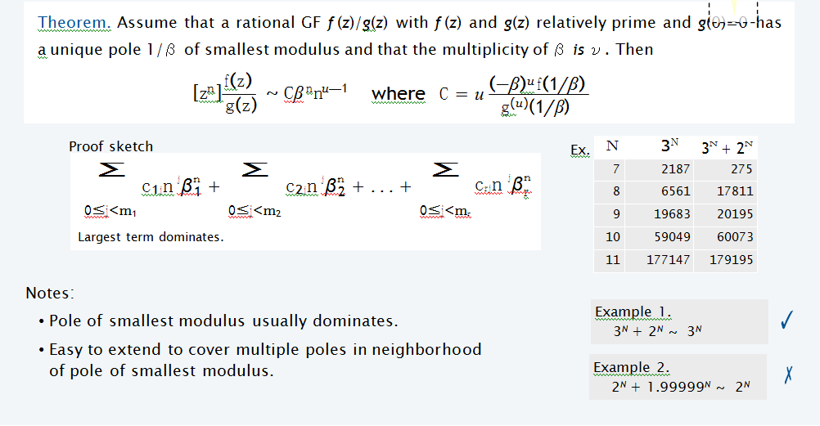

Slide 8
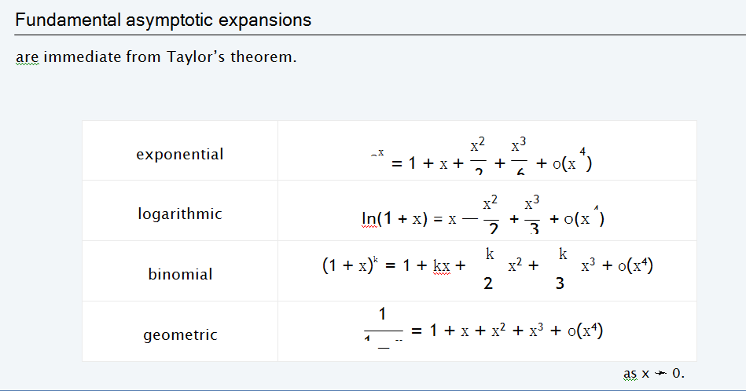

Slide 9
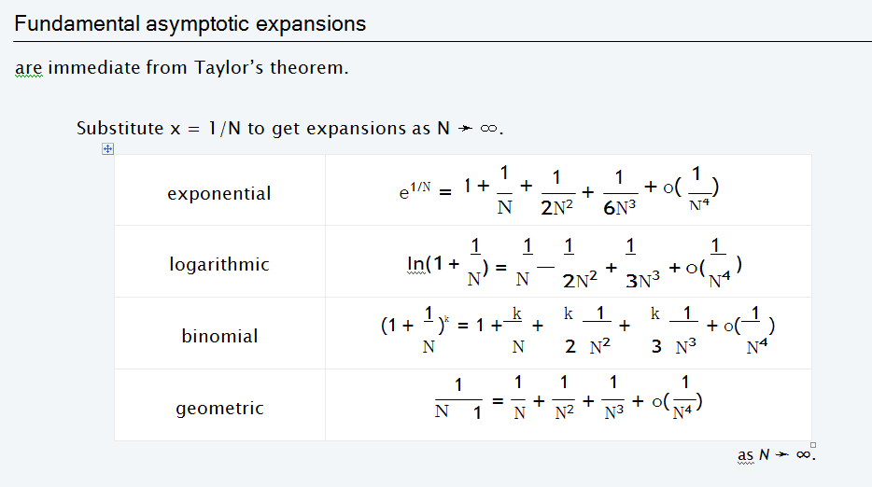

Slide 10
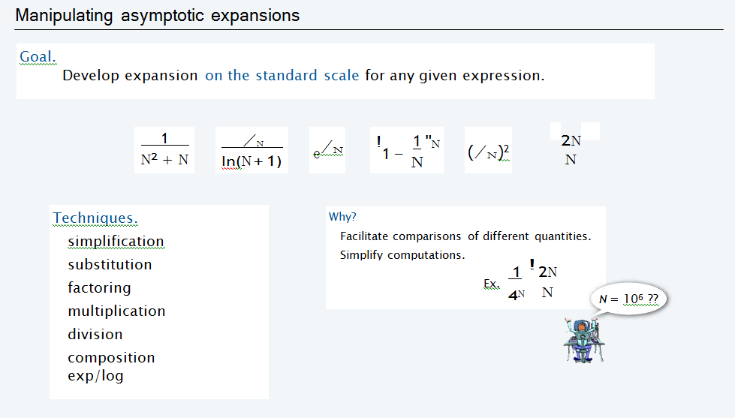
Manipulating Expansions

Slide 11
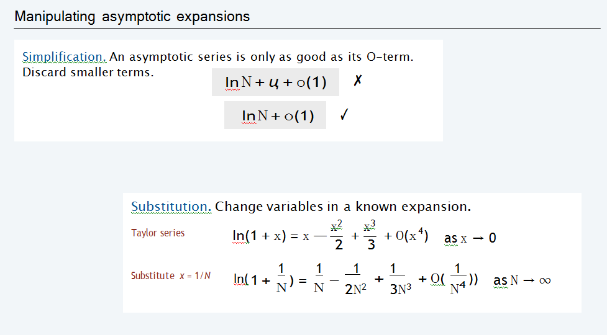

Slide 12
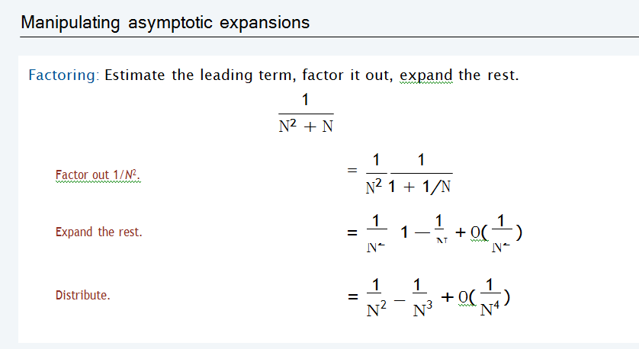

Slide 13
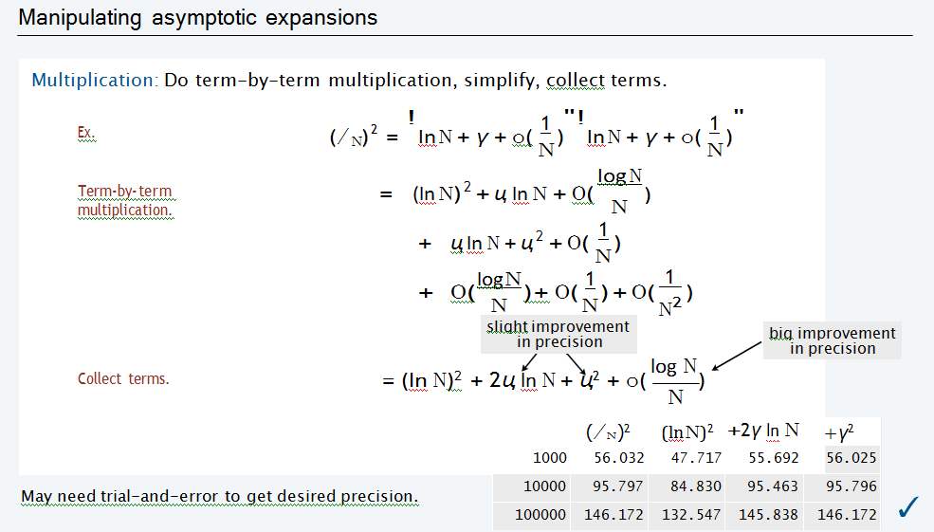

Slide 14
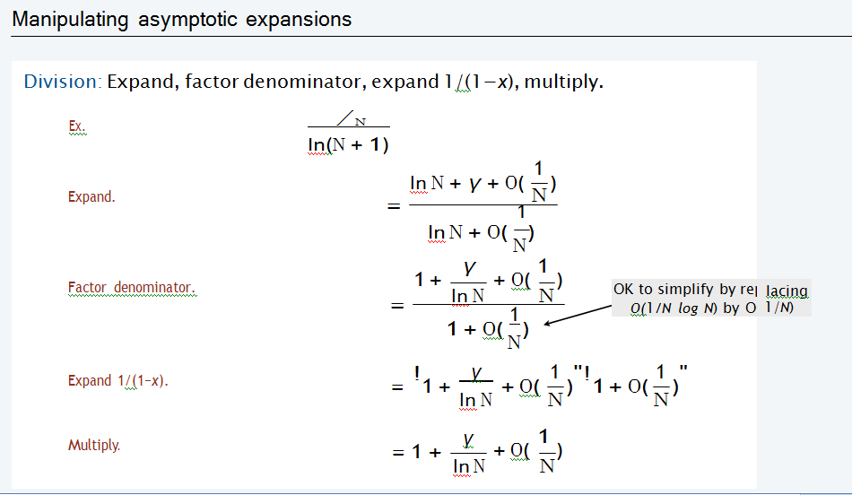

Slide 15
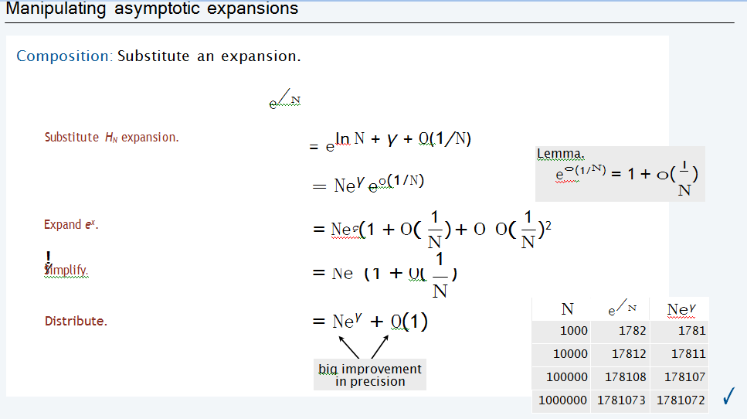

Slide 16
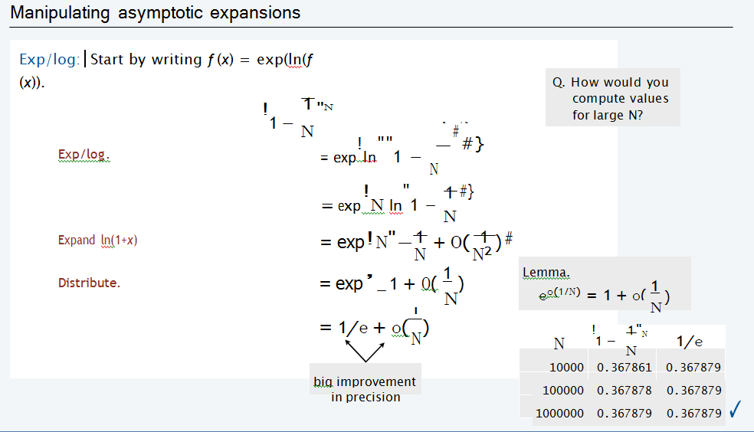

Slide 17
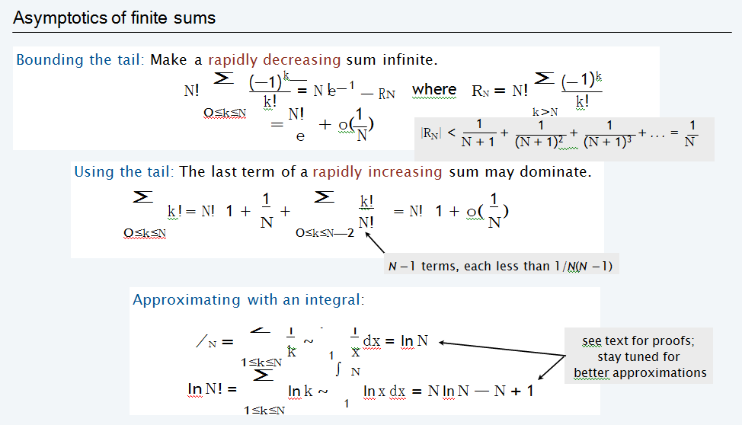
Asymptotic of Finite Sums

Slide 18
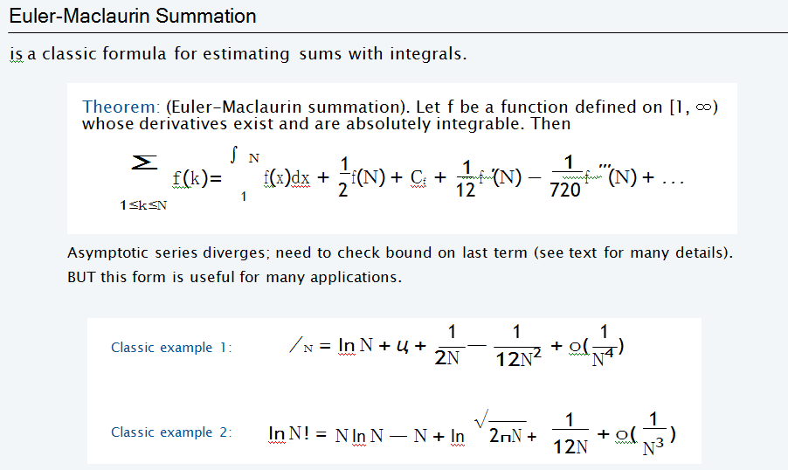

Slide 19
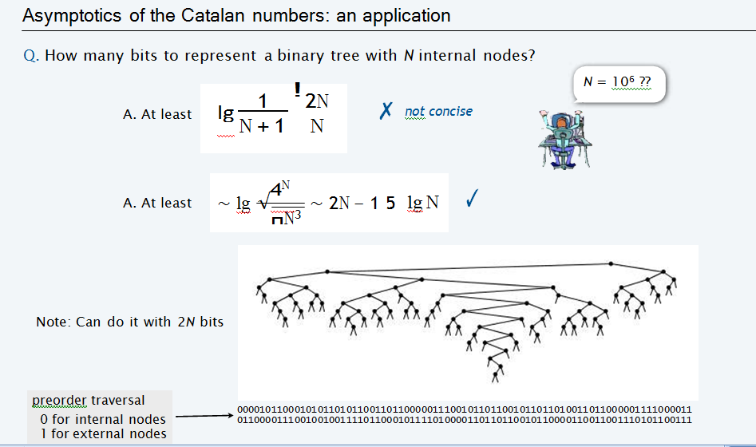

Slide 20
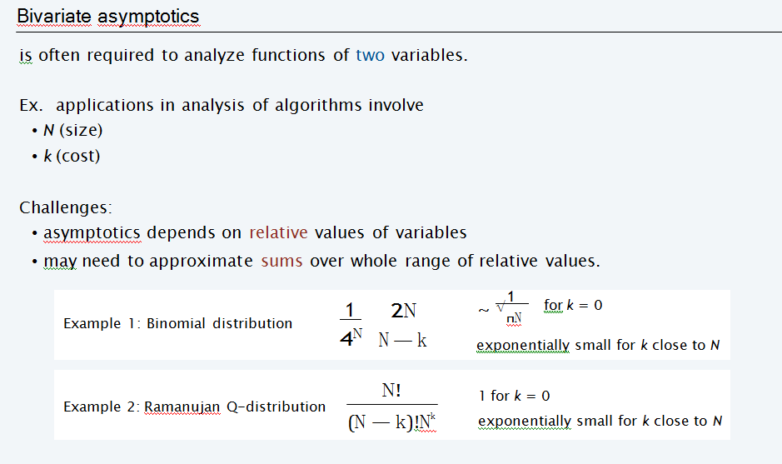

Slide 21
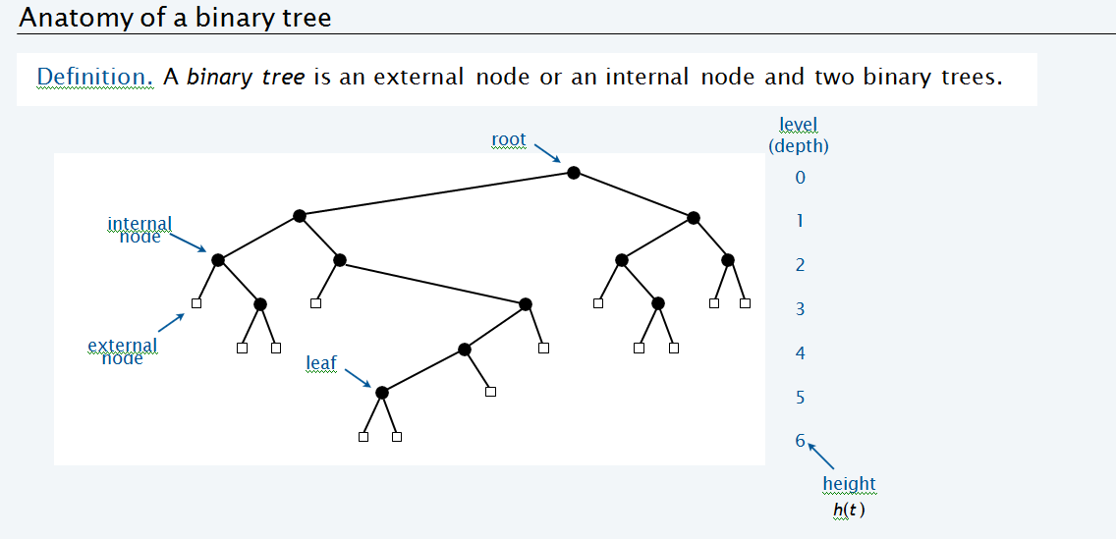
Trees: Trees & Forests

Slide 22
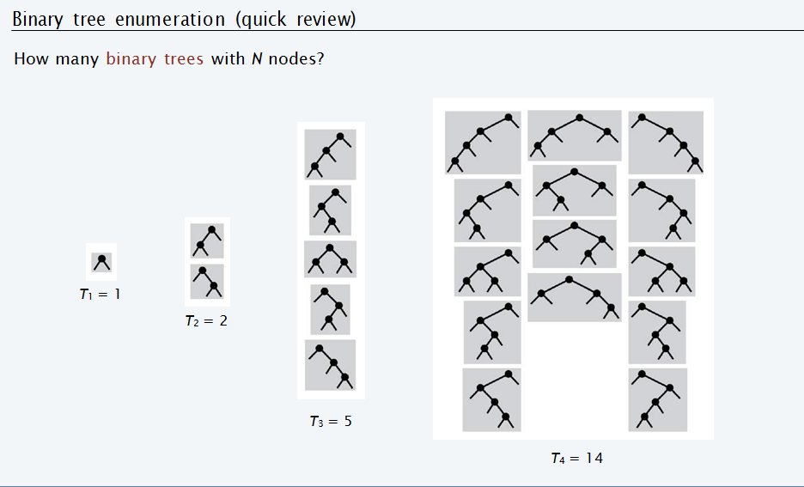

Slide 23
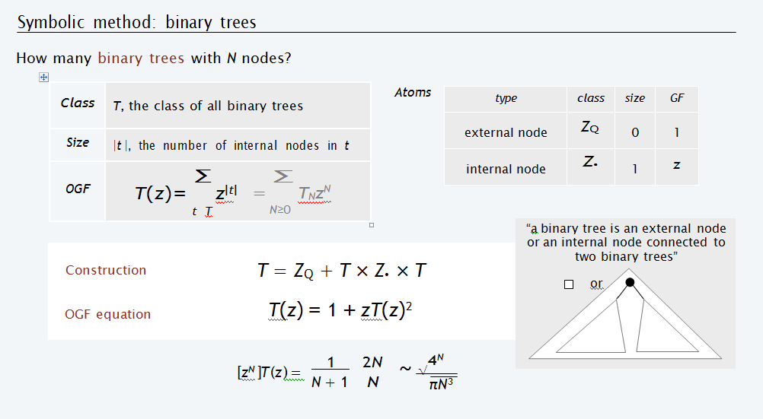

Slide 24
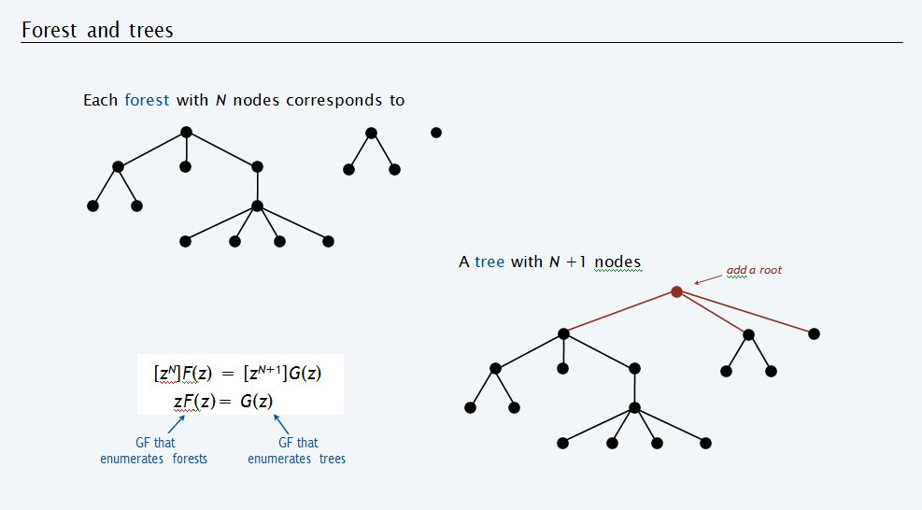

Slide 25
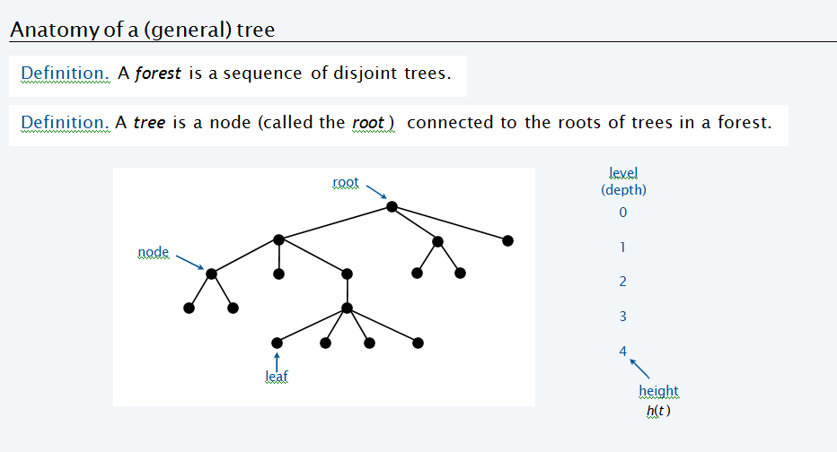

Slide 26
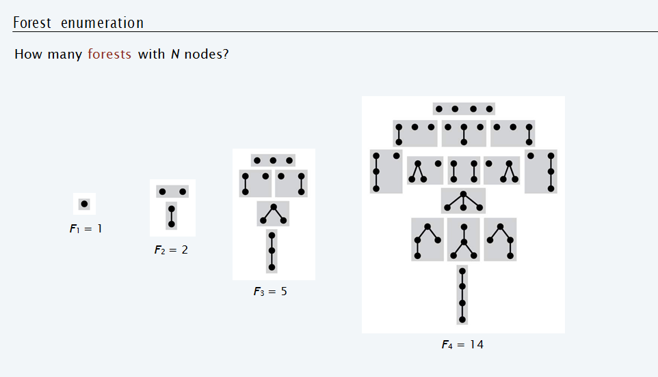

Slide 27
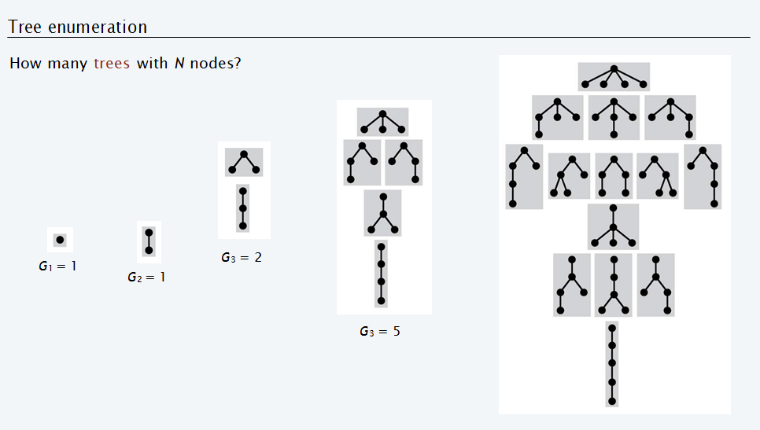

Slide 28
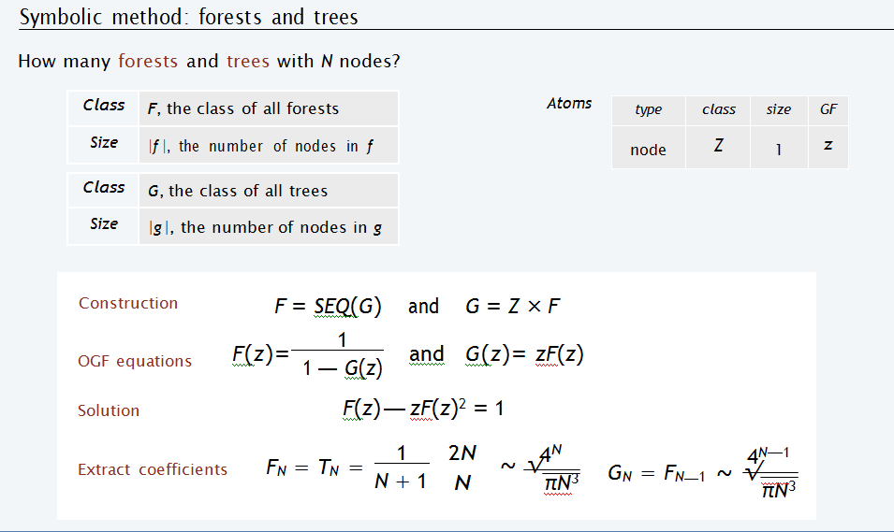

Slide 29
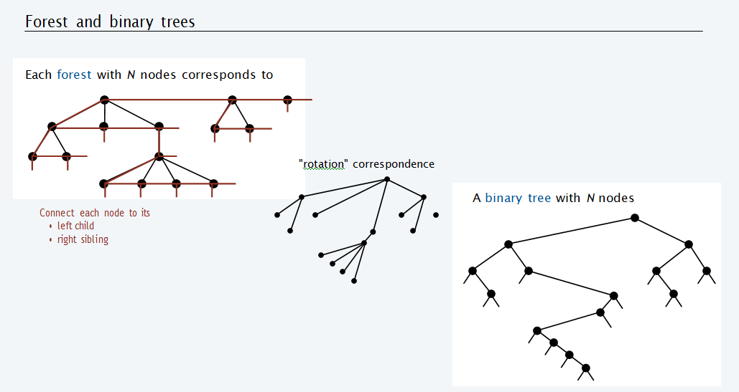

Slide 30
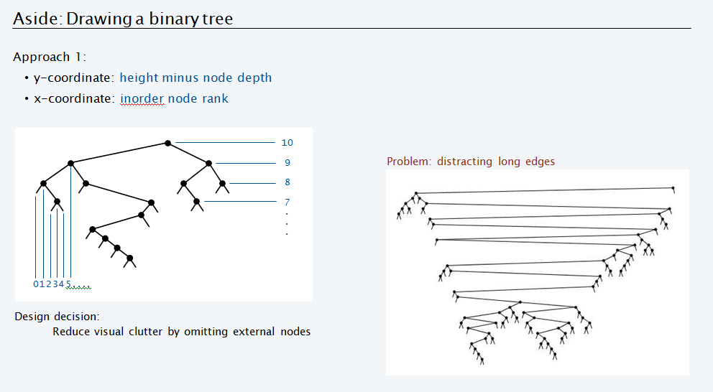

Slide 31
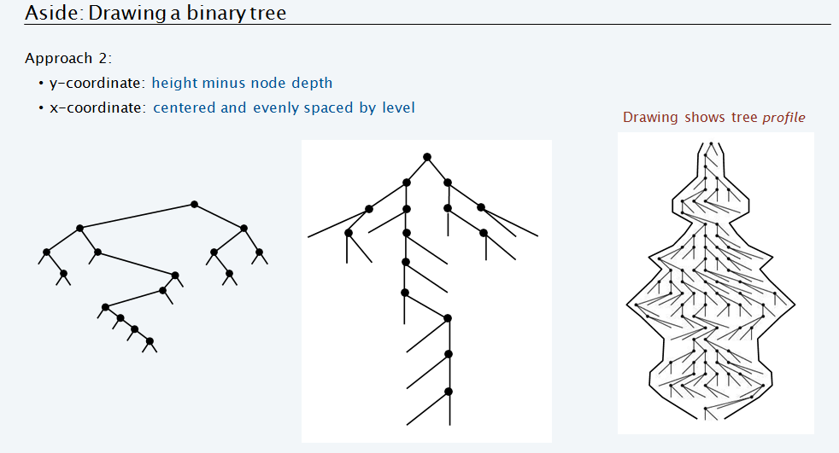

Slide 32
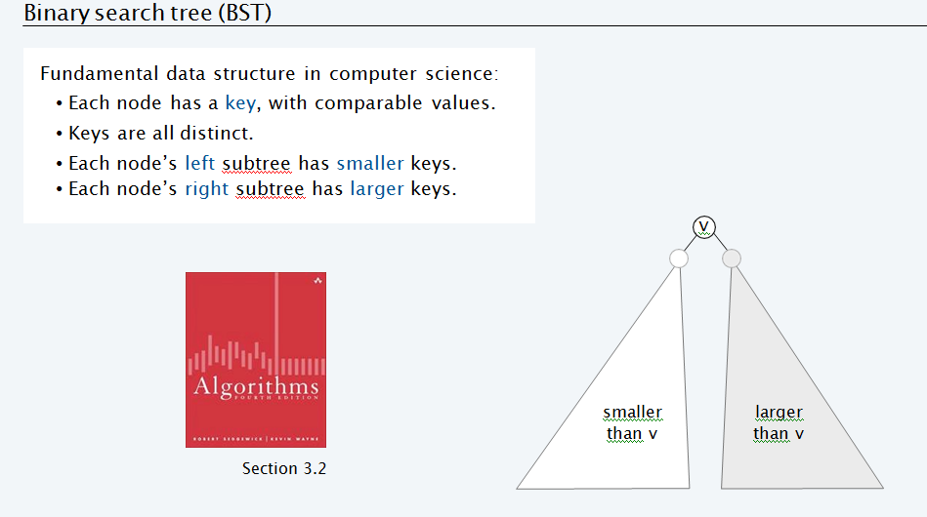
Binary Search Tree(BST)

Slide 33
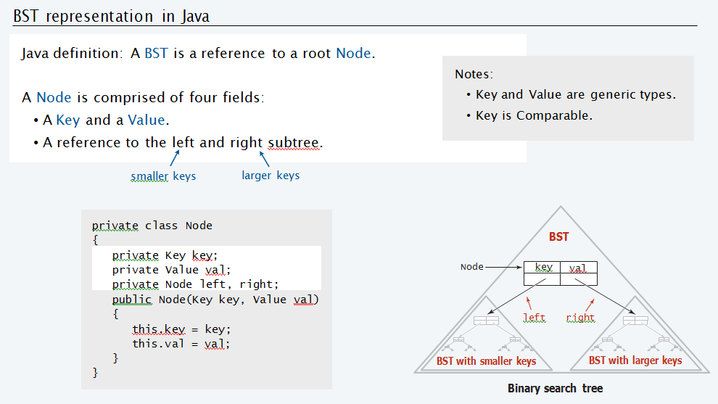

Slide 34
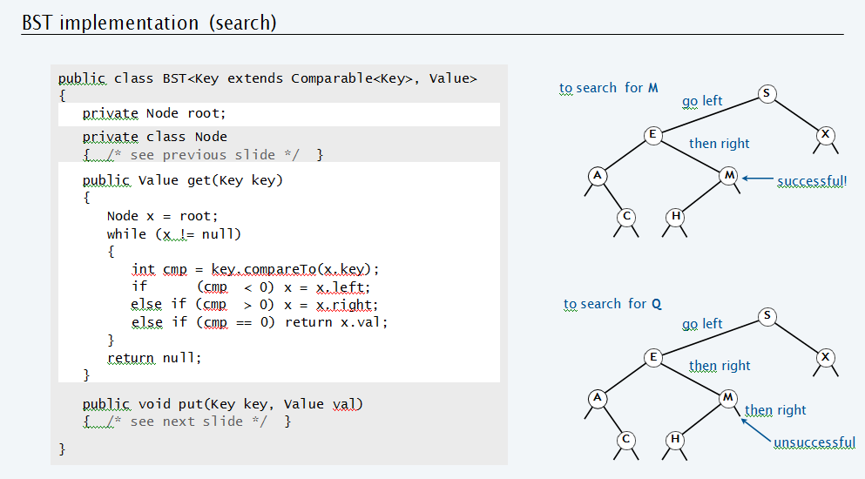

Slide 35
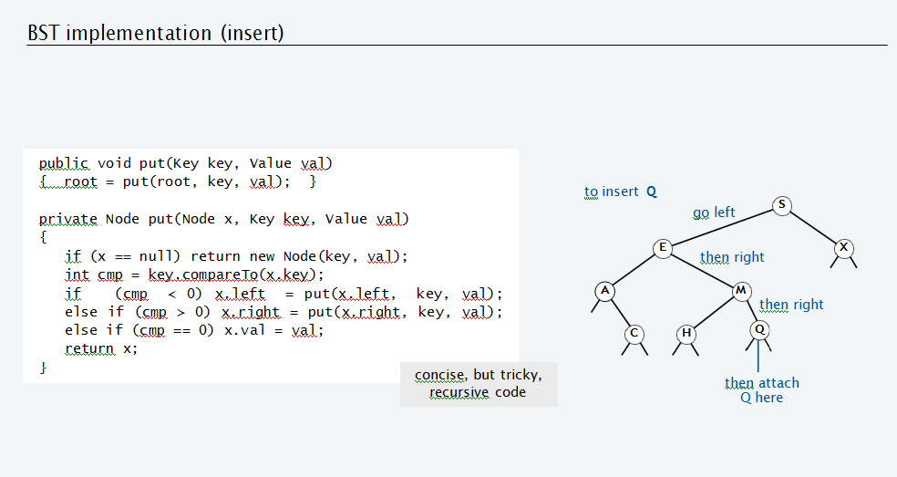

Slide 36
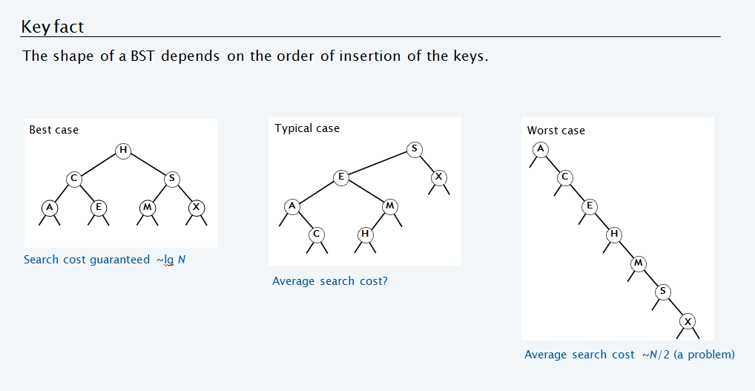

Slide 37
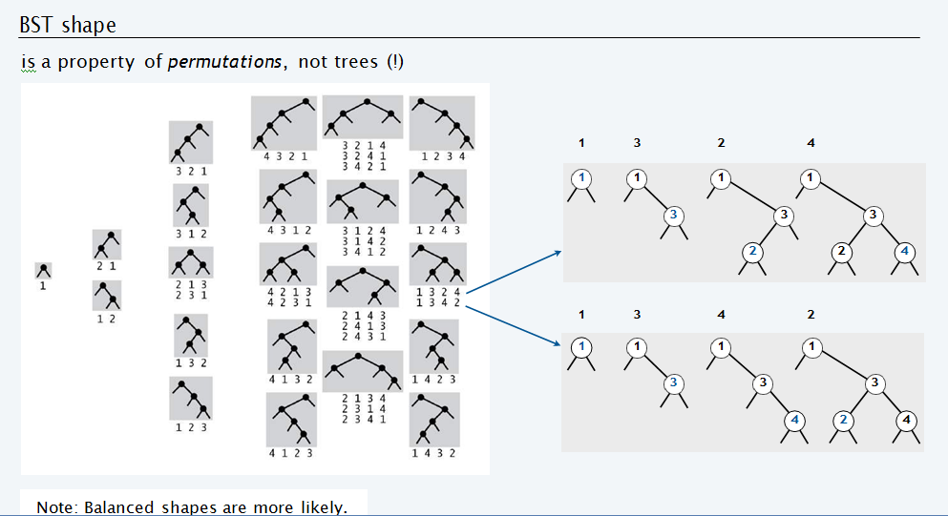

Slide 38
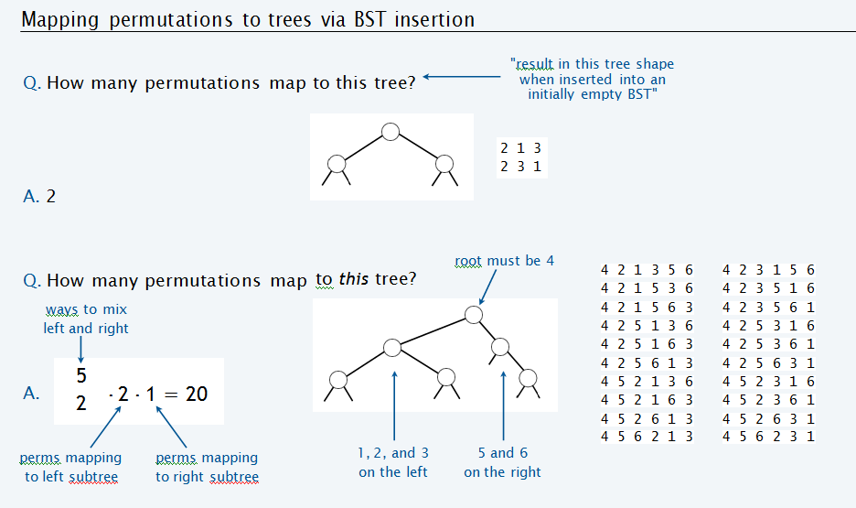

Slide 39
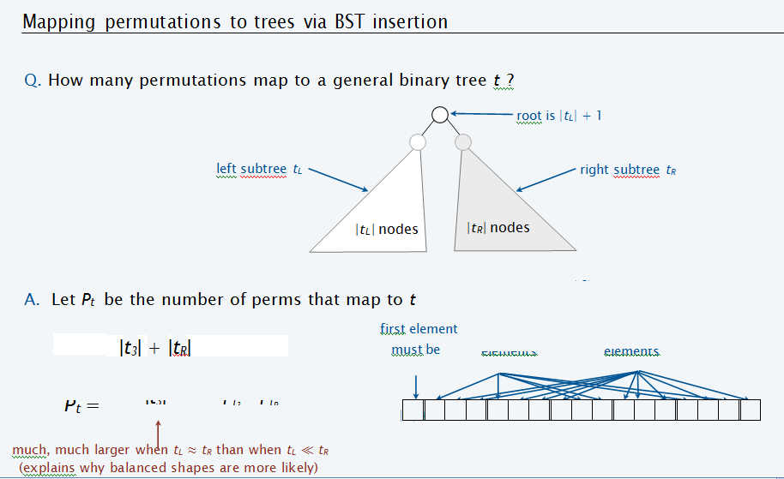

Slide 40
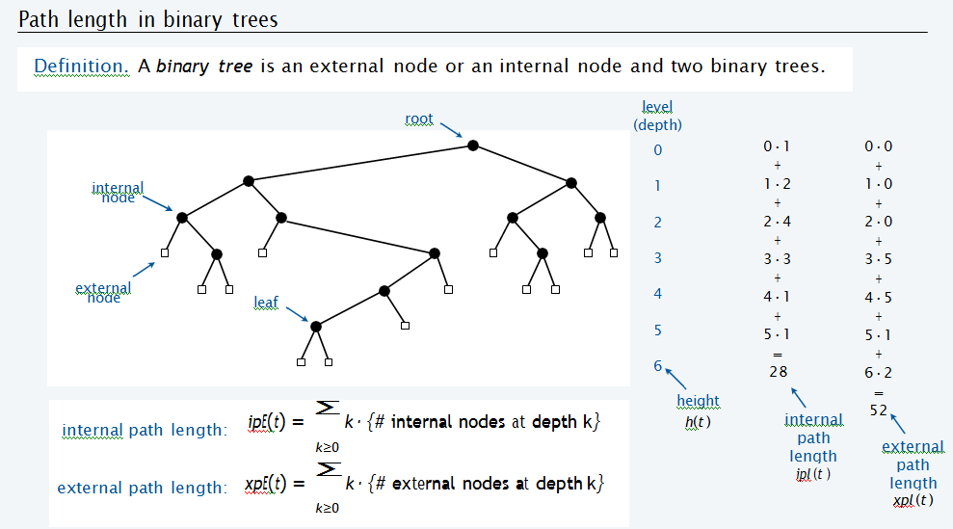
Path Length in BST

Slide 41
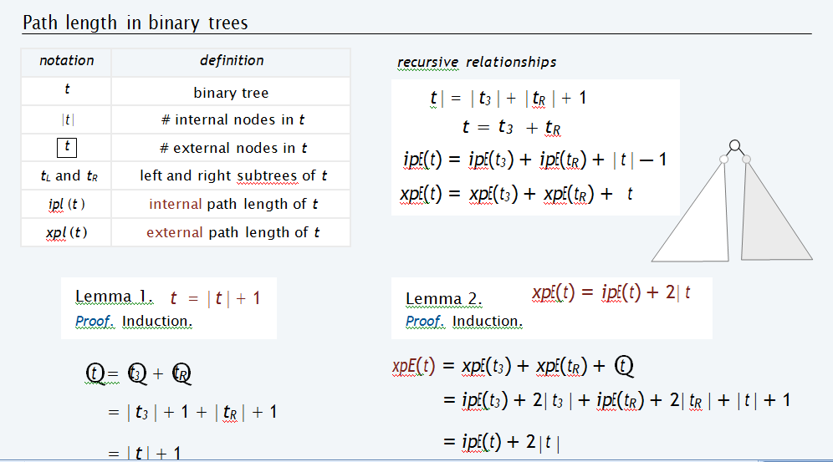

Slide 42
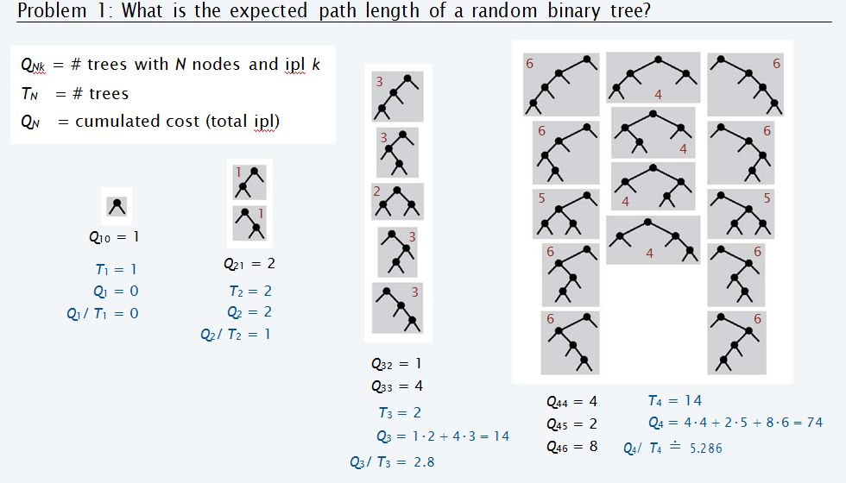

Slide 43
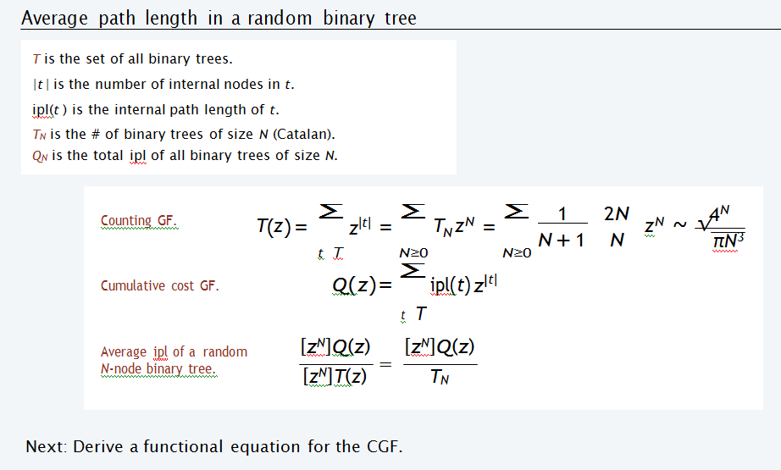

Slide 44
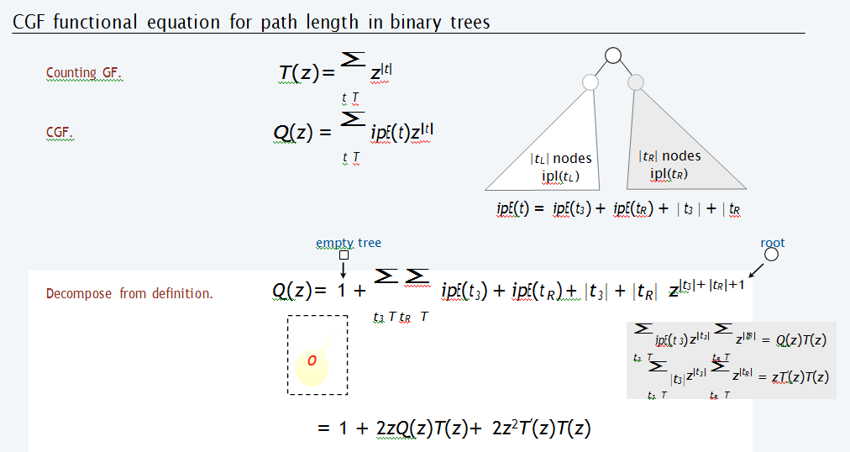

Slide 45
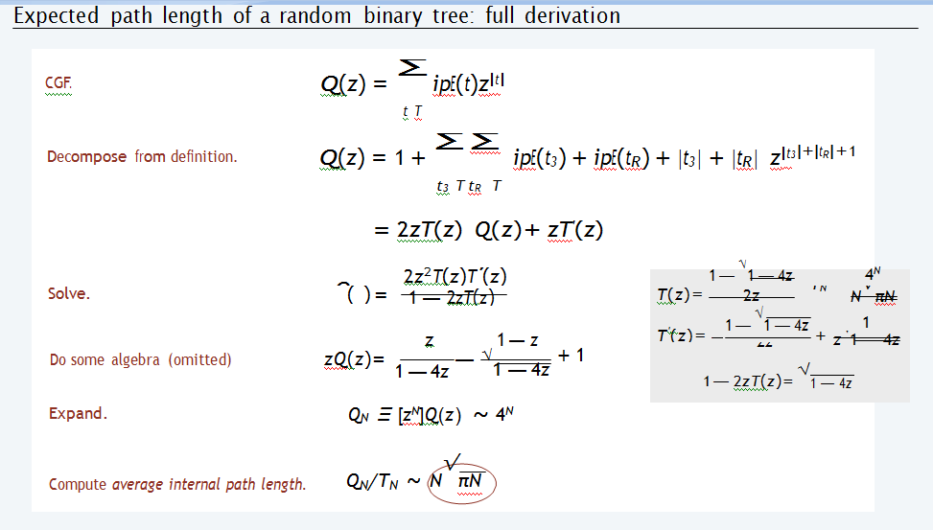

Slide 46
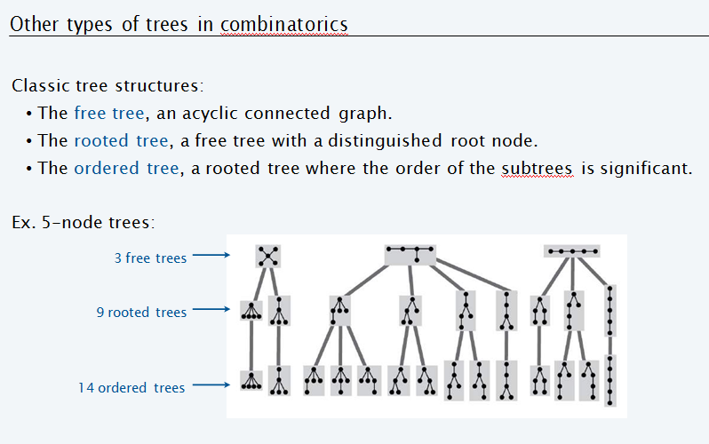
Other Types of Trees

Slide 47
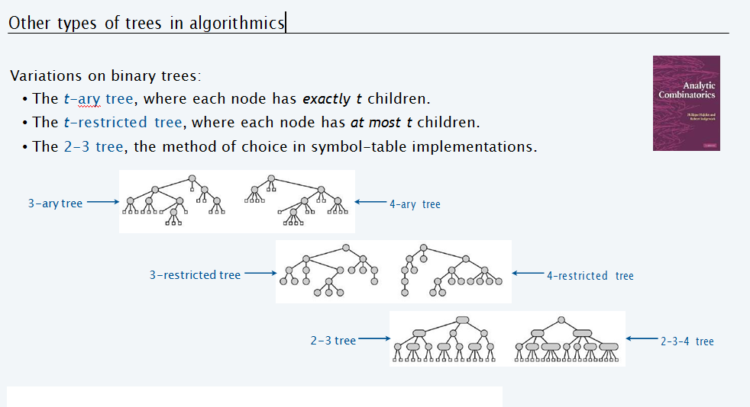

Slide 48
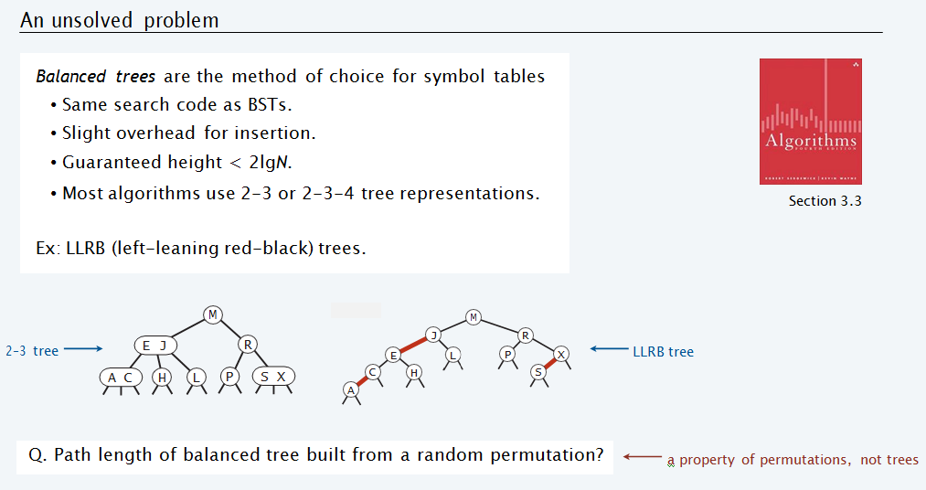

Slide 49
MCQ
________ of an algorithm refers to defining the mathematical boundation/framing of its run-time performance.
A. Symptotic analysis
B. Asymptotic analysis
C. Posterior Analysis
D. Priori Analysis
Notes:
B

Slide 50
Using asymptotic analysis, we can very well conclude the __________ scenario of an algorithm.
A. best case
B. average case
C. worst case
D. best case, average case, and worst case
Notes:
D

Slide 51
Which case indicate the minimum time required for program execution?
A. best case
B. average case
C. worst case
D. None of the above
Notes:
A

Slide 52
__________ is the formal way to express the upper bound of an algorithm's running time.
A. Omega Notation
B. Theta Notation
C. Big Oh Notation
D. All of the above
Notes:
C

Slide 53
Worst Case indicates maximum time required for program execution.
A. Yes
B. No
C. Can be yes or no
D. Can not say
Notes:
A

Slide 54
Which of the following is linear asymptotic notations?
A. Ο(1)
B. Ο(log n)
C. Ο(n)
D. Ο(n log n)
Notes:
C

Slide 55
Omega Notation is the formal way to express the lower bound of an algorithm's running time.
A. TRUE
B. FALSE
C. Can be true or false
D. Can not say
Notes:
A

Slide 56
Asymptotic analysis is _______ bound.
A. output
B. input
C. outer
D. inner
Notes:
B

Slide 57
What is the worst case time complexity for search, insert and delete operations in a general Binary Search Tree for a skewed tree ?
A)O(n)
B)O(nlogn)
C)O(2n)
D)None of the above
Notes:
a

Slide 58
In delete operation of BST, we need inorder successor (or predecessor) of a node when the node to be deleted has both left and right child as non-empty. Which of the following is true about inorder successor needed in delete operation?
(A) Inorder Successor is always a leaf node
(B) Inorder successor is always either a leaf node or a node with empty left child.
(C) Inorder successor may be an ancestor of the node
(D) All of the above.
Notes:
B

Slide 59
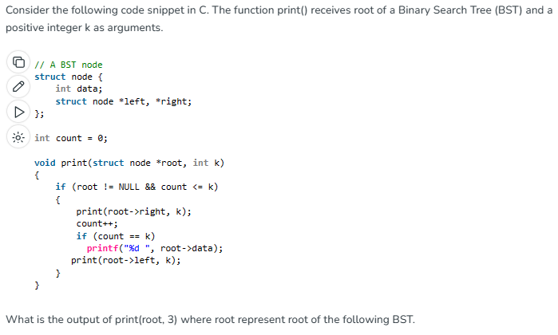

Notes:
B

Slide 60
The following numbers are inserted into an empty binary search tree in the given order: 10, 1, 3, 5, 15, 12, 16. What is the height of the binary search tree (the height is the maximum distance of a leaf node from the root)?
(A) 2
(B) 3
(c) 4
(D) 6
Notes:
B

Slide 61
What are the main applications of tree data structure?
1) Manipulate hierarchical data
2) Make information easy to search
3) Manipulate sorted lists of data
4) Router algorithms
5) Form of a multi-stage decision-making, like Chess Game.
6) As a workflow for compositing digital images for visual effects
(A)1, 2, 3, 4 and 6
(B)1, 2, 3, 4 and 5
(C)1, 3, 4, 5 and 6
(D)1, 2, 3, 4, 5 and 6
Notes:
D

